Slide 1

IPL Match Winner Prediction
Deepti Horakeri
B-5 Online
22/03/2025

Slide 2
Problem Statement:
Predict the winner of an IPL match based on various​ Features.​
​
Objective:
This project aims to predict the winner of an IPL match using machine learning models like Logistic Regression, SVM, Decision Trees, Random Forest, and XGBoost. The best model will be selected based on performance evaluation, and hyperparameters will be tuned for further improvement.
Dataset Overview:
The dataset includes match details such as season, city, date, teams, toss outcome, result, and winner. It also records victory margins (runs/wickets), Duckworth-Lewis application, player of the match, venue, and umpires.

Slide 3
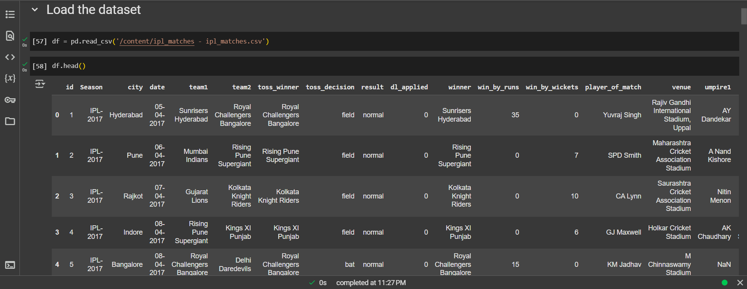
Dataset:

Slide 4
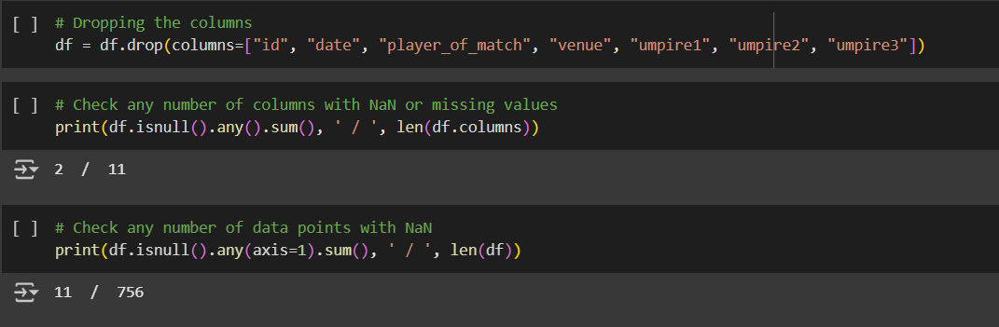
Data Preprocessing:
Dropped the unwanted columns.
Used forward fill to fill the null values since there were only 0.9 and 0.5 percentage of null values.
Encoding the categorical features into numerical for further process.

Slide 5
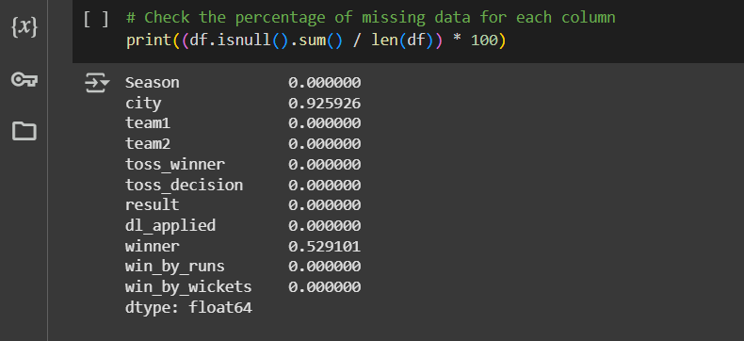
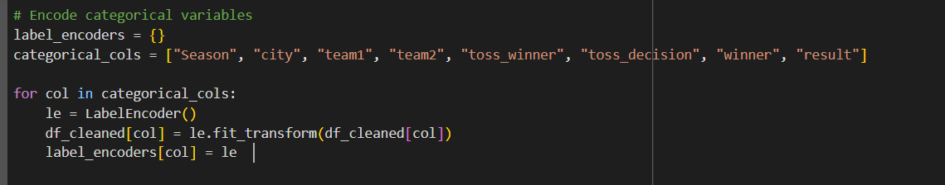

Slide 6
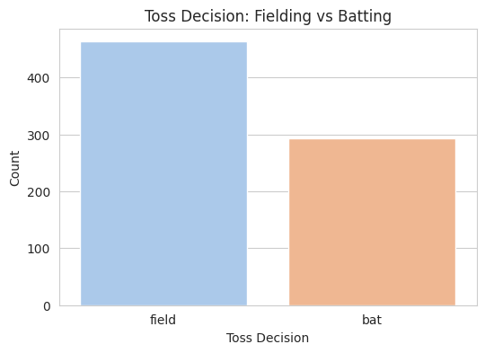
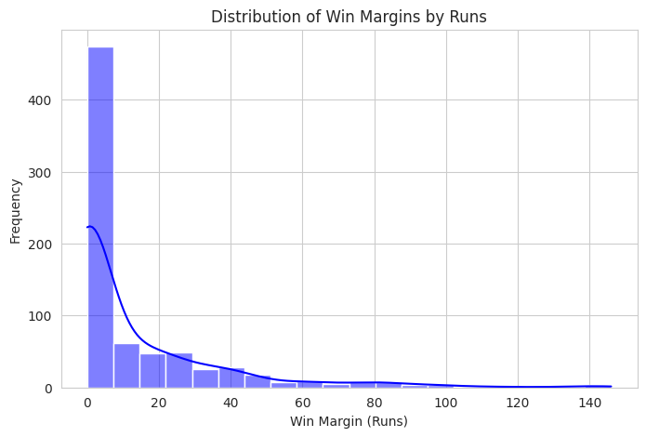
Exploratory Data Analysis (EDA):

Slide 7
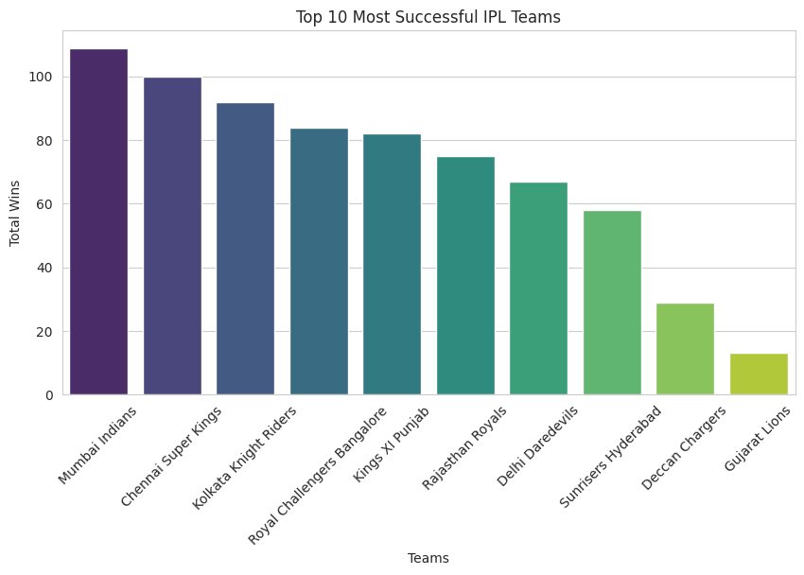


Slide 8
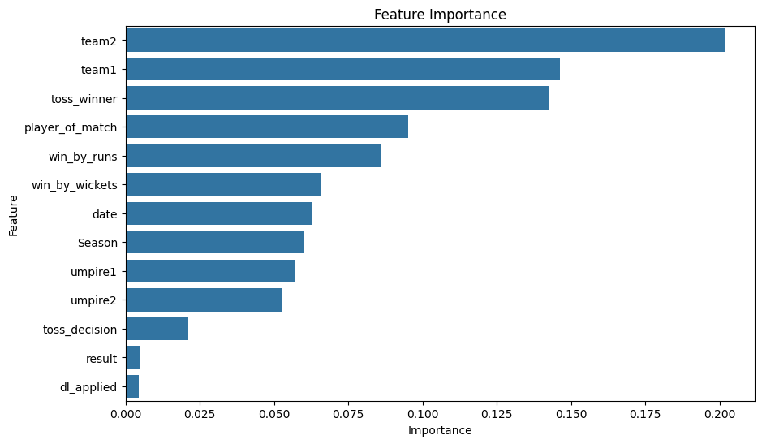

Slide 9
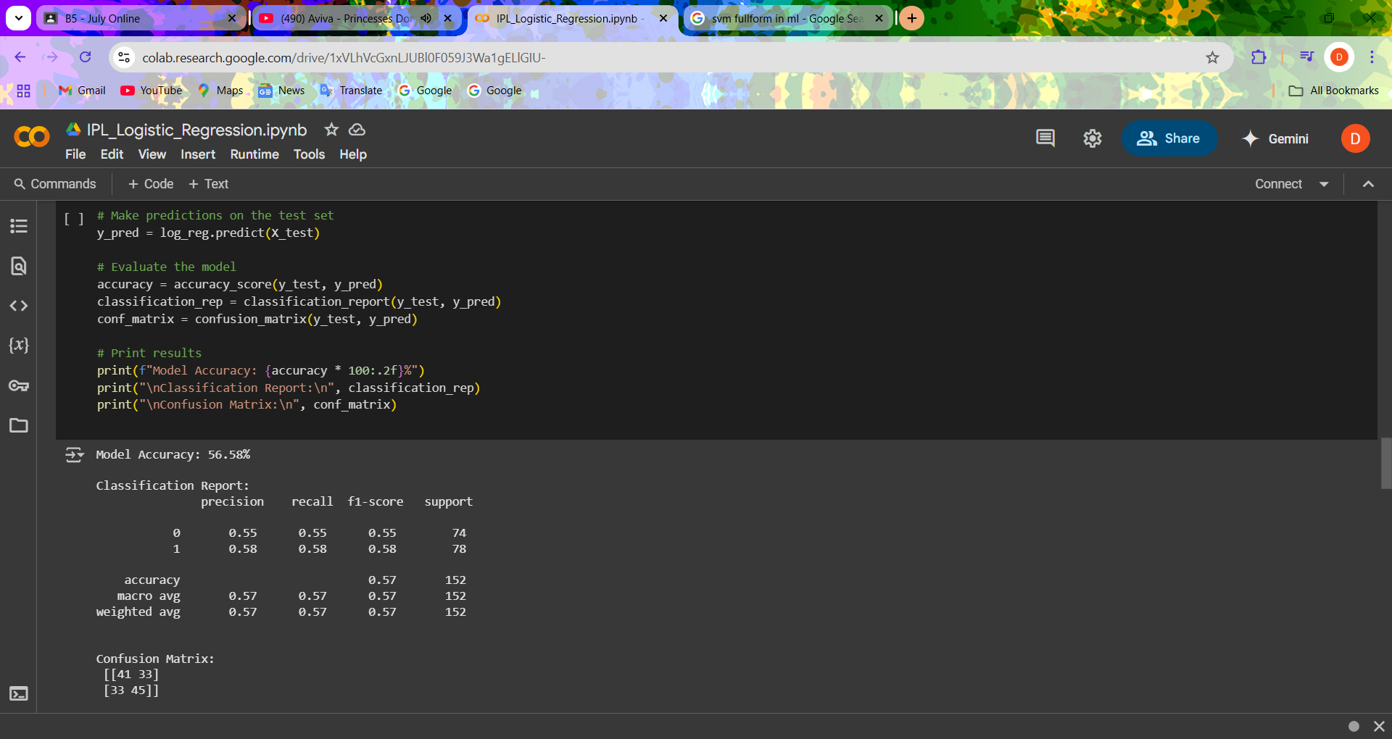
Modeling Process:
Models Used:
Random Forest Classifier
DT Classifier
XG Boost Classifier
SVM (Support Vector Machine)
Logistic Regression
Analyzing players performance with Random Forest Classifier
Logistic Regression :

Slide 10
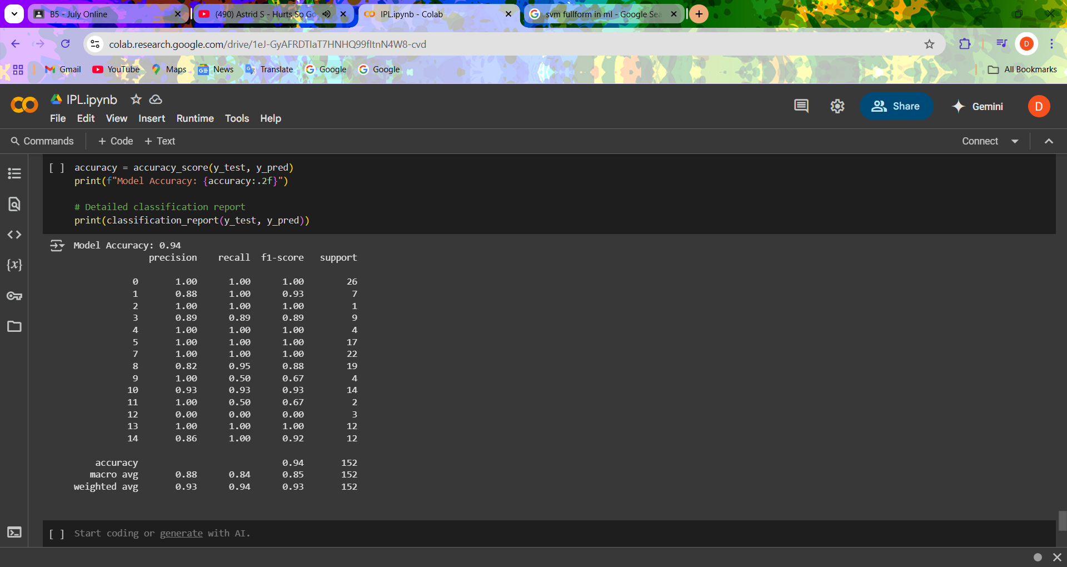
XG Boost Classifier :

Slide 11
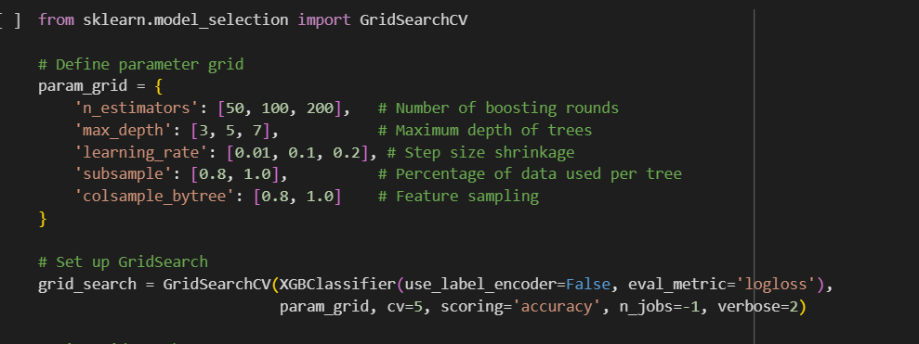
Hyperparameter Tuning :

Slide 12
Model Comparision :
Comparing the models performance on Comparision with each other's accuracy score XG Boost is having the highest score.
XG Boost has got the accuracy of 94%.
Random forest Classifier has got accuracy of 83%.
Logistic Regressor has got accuracy of 56.58%
SVM has achieved training accuracy of 62.07% and test accuracy of 65.78%.
DT(Decision Tree Classifier) has achieved accuracy of 41%.

Slide 13
Conclusion :
XGBoost is the most effective model in this comparison, achieving the highest accuracy of 94%, making it the best choice for the given dataset. Other models like Random Forest performed reasonably well, while Decision Tree and Logistic Regression showed lower accuracy, indicating they may not be suitable for this task.
Model can be improved by :
Ensemble Learning: Combine multiple models using bagging or boosting techniques to improve overall performance.
Regularization Techniques: Use L1/L2 regularization to prevent overfitting and enhance model robustness.
Increasing Training Data: Collecting more data or using data augmentation techniques can help models generalize better.

Slide 14
Key Insights:
The team with the highest number of wins is Mumbai Indians (MI), followed by Chennai Super Kings (CSK).
Chris Gayle has won the most "Player of the Match" awards.
His best year was 2011, where he secured 6 awards.
Matches are played across many venues, but Eden Gardens, Wankhede Stadium, and M. Chinnaswamy Stadium host the most games.
Most matches are won by wickets (chasing teams winning) rather than runs.

Slide 15

Thank You

